Slide 1
BUSINESS MODEL CANVAS
SILK SAREE TEXTILE BUSINESS
PRESENTED BY M.ASWINI

Slide 2
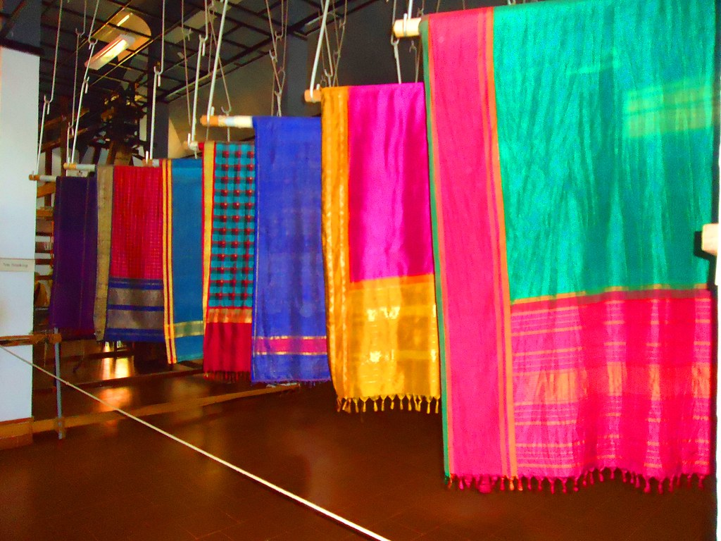
Customer Segments 👩‍👩‍👧
Women aged (20-30) Engagement/Marriage
Middle aged women(30-50) family functions and festivals
Elder women(50+) Temple visits and family functions

Slide 3
Value Proposition 💎
50 years of Trust
Traditional designs
Trending designs
Personalized customer service
Customization of saree
Guidance for saree selection
Trending blouse stitching and customization
Additionally different type of sarees also available

Slide 4
Key Resources
Silk saree inventory
Trusted suppliers
Skilled sales staff
Physical retail store
Long-term customer trust
Working capital

Slide 5
Channels 📢
Walk-in customers
Word of mouth
Family referrals
Local reputation
Whartsapp catalog
Instagram page

Slide 6
Customer Relationships 🤝
Personal interations
Friendly service
Long term trust
Loyal repeat customers
Customer database
Festival offer
Wedding collection promotions
Update for new arrivals

Slide 7
Revenue Streams 💰
Main revenue stream
Silk saree sales
Bridal sarees
Festival collections
Bulk purchases

Slide 8
Key Activities
Purchasing from suppliers
Managing stock
Customer assistance
Billing and sales
Displaying collections

Slide 9
Key Partners 🔗
Silk saree manufacturers
Saree wholesallers
Weavers
Tailoring units

Slide 10
Cost Structure 💸
Saree purchasing cost
Staff salaries
Shop maintenance
Electricity
Transportation
Packaging

